Slide 1
Galactic Evolution Workshop 2014.6.4-6.6 NAOJ
Nucleosynthesis of Elements heavier than Fe
through 3D inhomogeneous chemical evolution of the halo
銀河系ハローの三次元非一様化学進化による鉄より重い元素の合成
Sachie Arao, Yuhri Ishimaru (ICU)
Shinya Wanajo(Riken)

Slide 2
Ⅰ. Motivation -Problem posed by observational abundance-

Slide 3
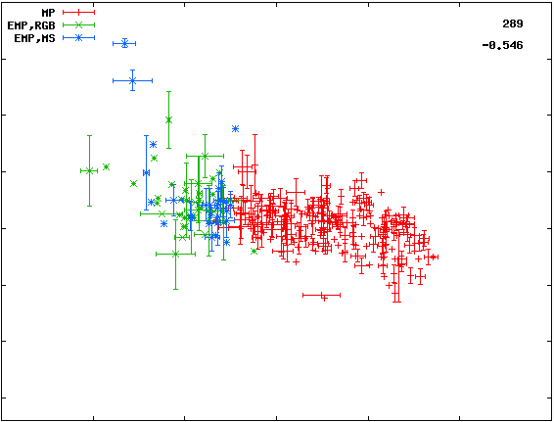
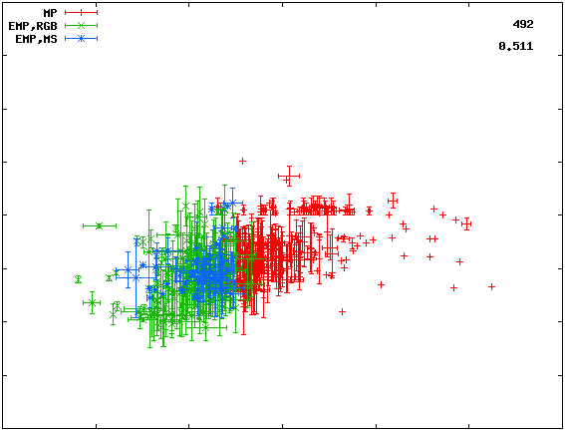
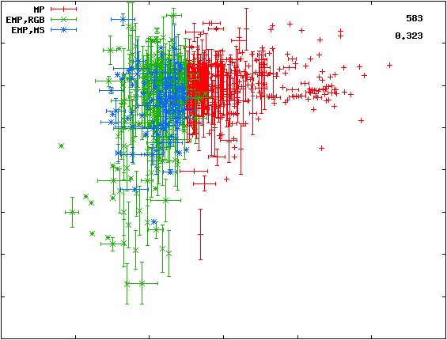
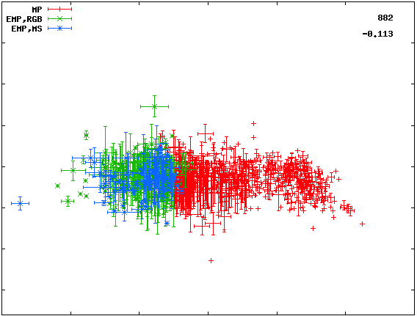
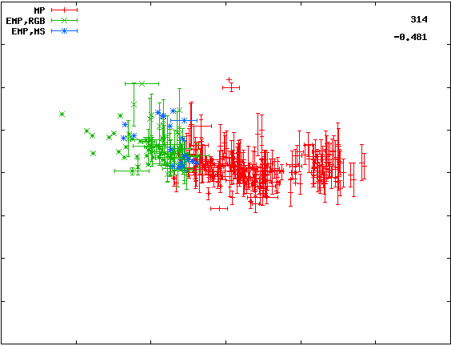
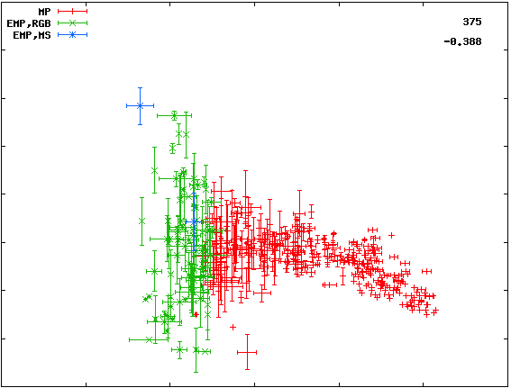
Observational traits of chemical abundance
−clues for the Galactic Chemical Evolution (GCE)−
α-elements
Fe-peak elements
n-capture elements?
2
1
2
O
different trends
& small dispersion
Mn
Sr
1
0
1
[El/Fe]
0
-1
0
-1
-2
-1
-3
large dispersion
-2
-5 -4 -3 [Fe/H] -1 0 1
-5 -4 -3 [Fe/H] -1 0 1
-5 -4 -3 [Fe/H] -1 0 1
2
Zn
3
2
Mg
Eu
1
2
1
[El/Fe]
0
1
0
-1
0
-1
-5 -4 -3 [Fe/H] -1 0 1
-2
-1
-5 -4 -3 [Fe/H] -1 0 1
-5 -4 -3 [Fe/H] -1 0 1
What kind of GCE model can explain consistently these different trends in abundance?
observational data : from SAGA database

Slide 4
Consistent GCE explanation for Zn and Sr ?
Fe-peak elements (Zn)
n-capture elements? (Sr)
2
1
1
0
[Zn/Fe]
-1
0
[Sr/Fe]
trend & small dispersion
-1
-2
-3
large dispersion
-2
-5 -4 -3 [Fe/H] -1 0 1
-5 -4 -3 [Fe/H] -1 0 1
homogeneous abundance?
(homogeneous model)
spatial inhomogeneity
of abundance ??
(inhomogeneous model)
the early halo
difficult to explain different trends of Fe-peak elements especially Zn
can explain small dispersion & trend of Zn as reproducing large dispersion of r-process elements?
examine inhomogeneous model supposed from r-process elements
observational data: from SAGA database

Slide 5
Ⅱ. Methods Modeling of 3D inhomogeneous GCE

Slide 6
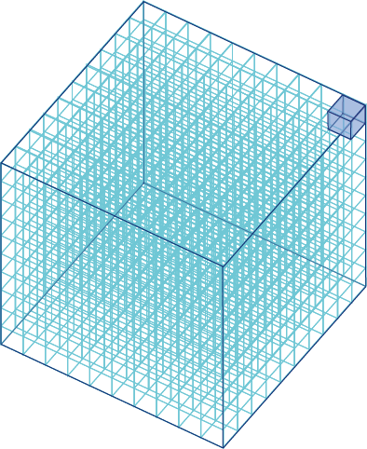
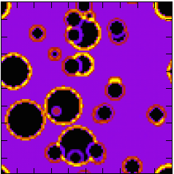
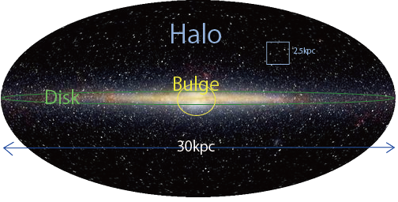
Modeling of GCE：Inhomogeneous Model
O:
outflow
★a system : (2.5kpc) ³ cube of the halo (100³ cells)
★reproduce spatial structure of chemical abundance
★Star formation: choose cell with
calculated probability (∝m_{G})
★SNe: distribute yield to surrounding cells
at calculated R_{SN}.
m_{S}: stellar mass
τ_{M}: lifetime
of star
X_{i}: ratio of
element I
in gas
m_{G}: gas density
star formation ：Ψ=νm_{G} [M◉/Gyr]
outflow: output of gas from the system
radius of SNe shock wave front R_{SN}:
initial mass fanction(IMF):Φ(M)=AM^{-X}
X=1.35(Salpeter)
ν [Gyr⁻¹]: star formation efficiency
100cells
2.5kpc
O=om_{G} [M◉/Gyr] o [Gyr⁻¹]:outflow efficiency
function of m_{G}, metallisity, and E_{explosion}
R_{SN}~100-300[pc]
※parameters ν[Gyr⁻¹], o[Gyr⁻¹]

Slide 7
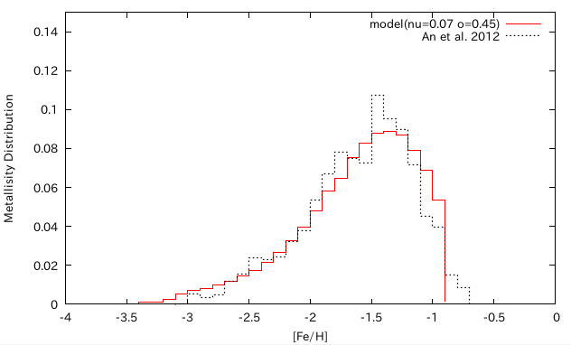
parameter choice by metallisity distribution
Modelー
Observation (An et al. 2012)・・・
parameters which reproduce metallisity distribution of the halo:
star formation efficiency ν=0.07[Gyr⁻¹] outflow efficiency o=0.45[Gyr⁻¹]

Slide 8
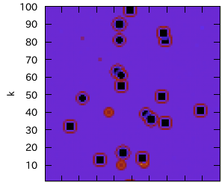
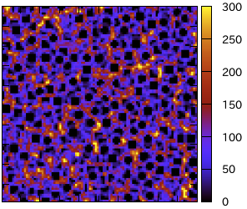
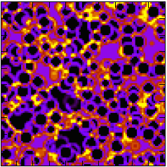
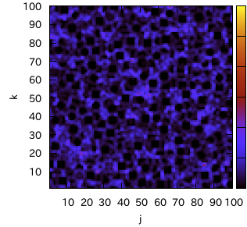
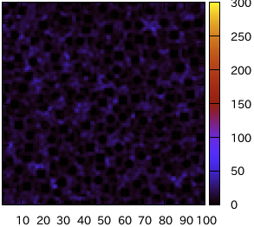
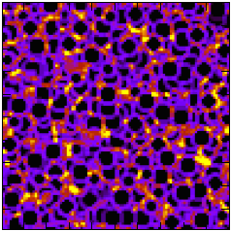
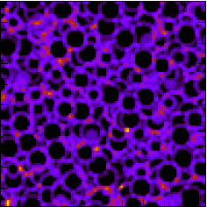
Inhomogeneous evolution of the halo (cross section of the system)
age of the Galaxy：20 Myr
100 Myr
gas density of cells
[M◉/cell]
gas is swept up by shock wave
500 Myr
2500 Myr
inhomogeneity of ISM occurs by different yields of each SNe,
and become more homogeneous through the time

Slide 9
Ⅲ. A Possible Solution
for the issue
explanation for Zn?
-Electron Capture SN-

Slide 10
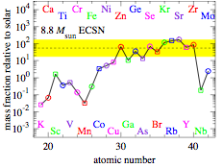
Possible Solution for Znproblem: ECSN
Electron Capture Supernova（ECSN）: a part of 8-10M◉ (※lower limit of ECSN unknown)
O-Ne-Mg core gravitationally collapse
by electron capture
long lifetime, low E_{explosion} ~10^50erg (<10^51erg(SNII))
envelope(H,He)
O-Ne-Mg core
ECSN model (considering SNe hydrodynamics)
(Wanajo et al. 2011, 2013)
8.8M◉ECSN produce Zn-Zr sufficiently
yield: Zn…higher than Fe
Fe…~10^-1 lower than SNII
ECSN yield
Zn
Sr
solar fraction
Co
Fe
explain observational trend of Zn with ECSN yield?? → consider SNII+ECSN
Cr
Mn
Supposition & Approximation in GCE model
ECSN lower limit →9M◉
E_{explosion} →E_{ECSN}=E_{SNII}=10^51[erg]
only ECSN is considered as origin for Sr
Wanajo+ 2013

Slide 11
Ⅳ. Results and Discussions
Zn: SNII & SNII + ECSN,
comparison with homogeneous
Zn & Sr : SNII + ECSN

Slide 12
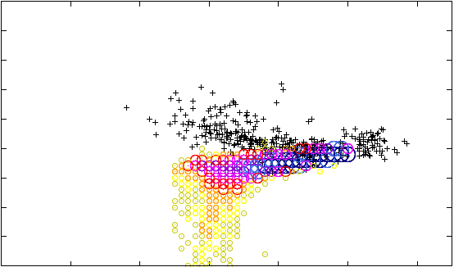
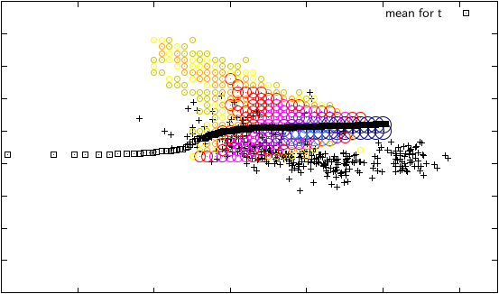
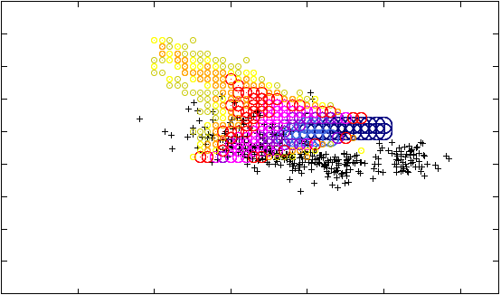
Result① : Zn (noECSN&ECSN)
 | SNeII | SNeII + ECSN
Zn
ECSN:
M_{low}
=9.0
○ number density of model star
2
2
1
1
0
0
[Zn/Fe]
[Zn/Fe]
ν=0.07
[Gyr⁻¹]
o=0.45
[Gyr⁻¹]
-1
+ observation
(SAGA database)
-1
-2
-2
-6 -4 -2 0
-6 -4 -2 0
[Fe/H]
[Fe/H]
SNII+ECSN→ can explain large values at low [Fe/H] and
the decreasing trend
effect of low Fe yield and higher Zn yield than Fe of ECSN
homogeneous model : shows increasing trend
mean abundance → ECSN effect appears at high [Fe/H] (=later) ※[Fe/H]∝time

Slide 13
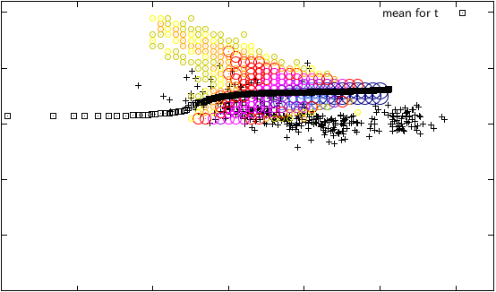
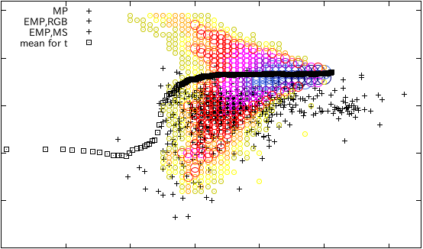
Result② : Zn & Sr
 | Zn | Sr
ECSN:
M_{low}
=9.0
2
+ observation
(SAGA database)
2
SNeII
+
ECSN
ν=0.07
[Gyr⁻¹]
o=0.45
[Gyr⁻¹]
0
0
[Zn/Fe]
[Sr/Fe]
-2
-2
-3
○ number density of model star
-3
-6 -4 -2 0
-6 -4 -2 0
[Fe/H]
[Fe/H]
consistently explain trend of Zn and large dispersion of Sr
need to examine other origins of Sr & approximations

Slide 14
Ⅴ. Summary
make a 3D inhomogeneous GCE model
As considering ECSN, Inhomogeneous model can
explain trend of Zn better than homogeneous model
explain consistently the trend of Zn and
large dispersion of Sr in observation
Future Plan: examine other origins of Sr (r-process),
parameters & approximations

Slide 15
Reference
Prantzos, N. 2008, “An Introduction to Galactic Chemical Evolution”
Argast, D., Samland, M., Thielemann, F.-K., & Gerhard, O.E. 2000, Astronomy & Astrophysics, Volume 356, pp.873-887
Sneden, C., Cowan, J. J. 2003, Science, Volume 299, p.7
Norris et al. 2001, THE ASTROPHYSICAL JOURNAL, 561:1034-1059
Francois et al. 2004, A&A 421, 613–621
Nomoto et al. 1997, nphysa, 616, 79
Cioffi et al. 1988, THE ASTROPHYSICAL JOURNAL,
334: 252-265

