Slide 1
Accelerated Evolution of Lya LF at z>7 and the Physical Pictures
(arXiv:1404.6066)
Akira Konno (Univ. of Tokyo, ICRR)
Co-Investigators:
M. Ouchi, Y. Ono, K. Shimasaku, T. Shibuya,
H. Furusawa, K. Nakajima, Y. Naito, R. Momose,
S. Yuma and M. Iye

Slide 2
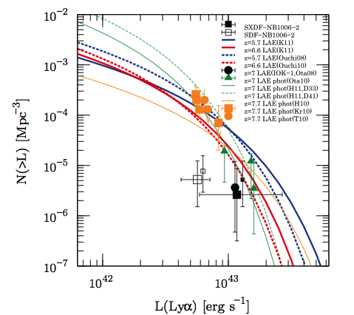
Introduction
Shibuya+ 12
Ouchi+ 10
z~7.3
(Hibon,Tilvi,
Krug)
CMB
z=6.6
LAE/
GRB
?
z=5.7
Neutral Fraction x(HI)
z~7.3
(Ota,
Shibuya)
QSO
Redshift
Lya LF evolves from z=6.6 or not ?
Lya damping wing absorption of HI in IGM
Sharp or extended reionization history ?
  ⇒ z=7.3 LAE survey address these issues.

Slide 3
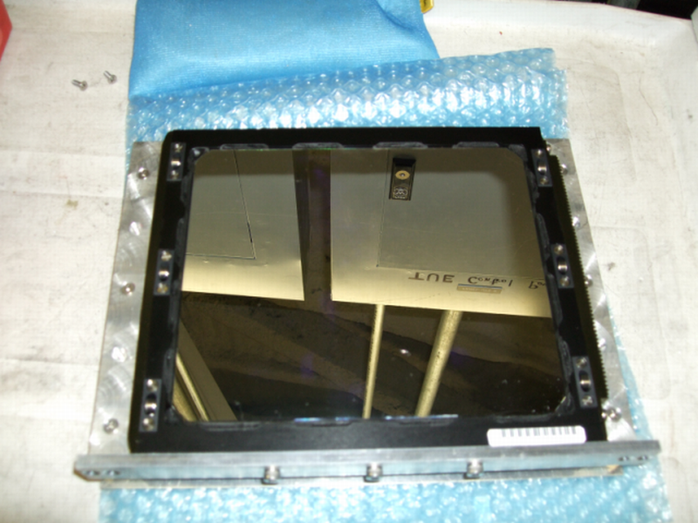
Subaru/S-Cam NB101 Obs.
Konno+ 14
NB101 … more sensitive to line emission than NB1006
Total exp. time : 106 hrs … Ultra-deep survey
⇒ Detect very faint LAEs at z=7.3
5-sigma limiting L(Lya) = 2.4 x 10⁴² erg/s
… comparable with z=3-6 LAE survey
… ~4x deeper than Subaru z~7.3 survey

Slide 4
z=7.3 LAE sample
Field … SXDS and COSMOS (Total : ~0.5 deg²)
SXDS : 3 LAEs
COSMOS : 4LAEs
… Total : 7 LAEs
Expect ~65 LAEs in case of no evolution from z=6.6.
Konno+ 14

Slide 5
Evolution of Lya LF at z=6.6-7.3
z=5.7
(Ouchi+ 08)
Inner : 68% CL
Outer : 90% CL
z=6.6
(Ouchi+ 10)
z=6.6
(Ouchi+ 10)
z=7.3
(This Study)
z=7.3
(This Study)
Konno+ 14
Konno+ 14
Conclude that Lya LF decrease from z=6.6 to 7.3
at >90% confidence level.
( Shown by previous studies ; e.g. Clement+12 )

Slide 6
Accelerated Evolution of Lya LF
Ellis+ 13
Bouwens+14
~ SFRD
Ouchi
+08, 10
UV luminosity density
Lya luminosity density
This
Study
Konno+ 14
arXiv:1404.6066
Evolution of Lya LF is accelerated at z>7.
No such rapid decrease of UV LF at z~7, but only for z~8.
Different from a pure SFR decrease but related to
Lya escape + production and/or cosmic reionization

Slide 7
Imprecations from Lya LF Evolution
x(HI) = 0.3-0.8
  … consistent with previous studies
Compare our x(HI) with CMB results using theoretical models.
Our x(HI) → Model A & B
… inconsistent with CMB results
WMAP result → Model C
… x(HI) is higher than Model C
A tension between our x(HI) and CMB results ?
  Clumpy HI clouds
  Increase of f_esc of LyC
Model A
Model B
Model C
Choudhury+08
models
(Bolton & Haehnelt 2013)
(Dijkstra+ 2014)
Konno+ 14

Slide 8
Summary
Ultra-deep Subaru/S-Cam NB101 imaging survey allow us to detect very faint z=7.3 LAEs.
  L(Lya) = 2.4 x 10⁴² erg/s … comparable with z=3-6 survey
  … ~4x deeper than z~7.3 survey
Evolution of Lya LF at z=6.6-7.3 at >90% CL
(2) Accelerated evolution of Lya LF beyond z=7
There is a tension between our x(HI) = 0.3 - 0.8 and CMB results ?
  Support new physical pictures
high-z LAE survey with HSC → PFS, JWST, TMT etc…

