Slide 1
Star Formation Main Sequence and Beyond: tracking down the environ-mental impacts on the SFR-M★ relation out to z~2
銀河進化研究会 2014/6/5 @国立天文台三鷹
Yusei Koyama (ISAS/JAXA)
MAHALO-Subaru collaboration

Slide 2
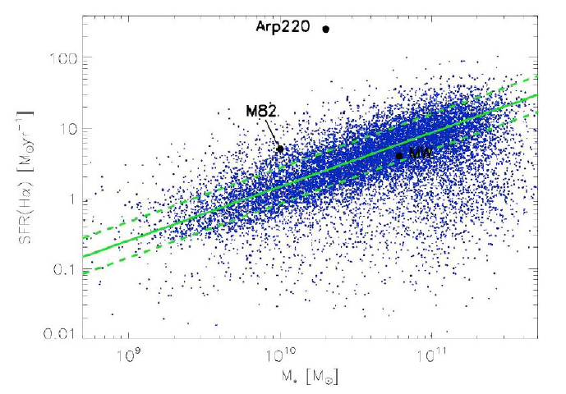
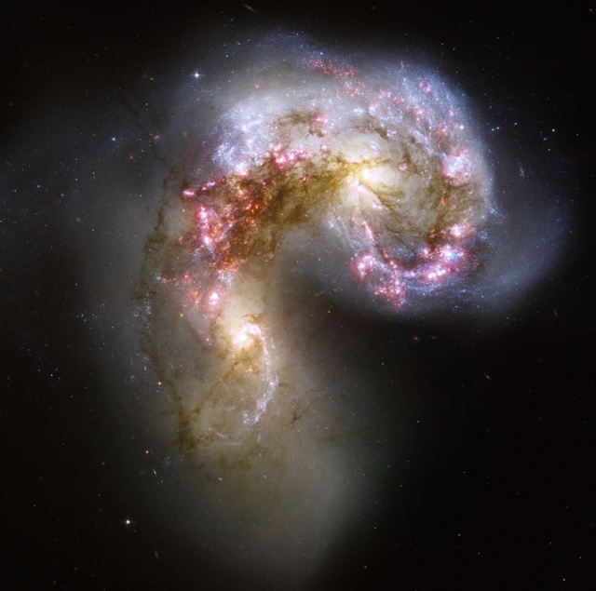
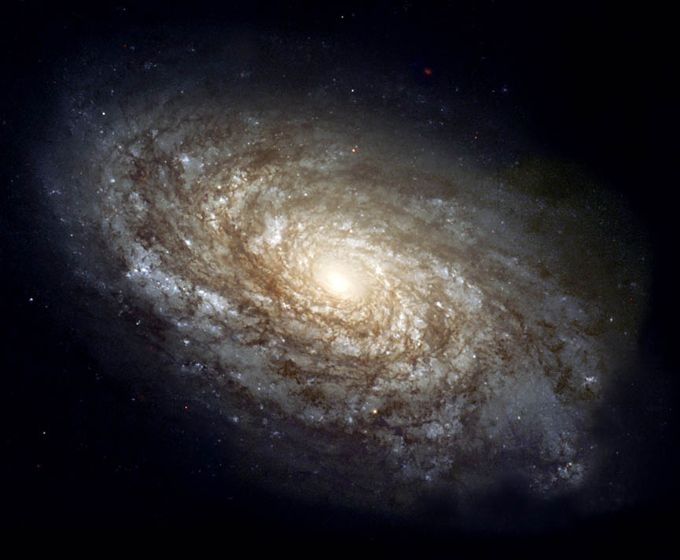
Star Formation “Main Sequence”
= SFR-M★ relation for star-forming galaxies
Starburst
merger
disk
SFR [M/yr]
Main Sequence (normal SF)
Passive
log M★ [M]
Elbaz et al. (2007)

Slide 3
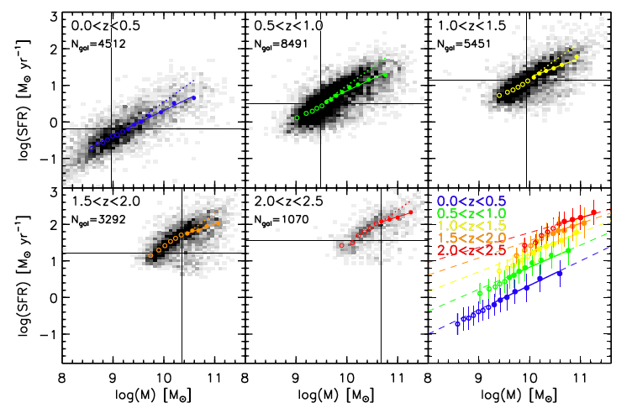
SF main sequence out to z>2
From NEWFIRM medium-band survey (Whitaker et al. 2012)

Slide 4
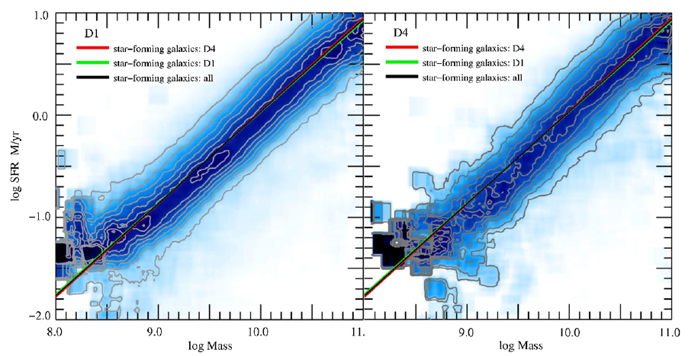
Main sequence vs. environment (z=0)
SF main sequence is “independent” of environment at z=0
log SFR [M/yr]
low-density
(z=0)
high-density
(z=0)
log M★
Local star-forming galaxies from SDSS (Peng et al. 2010)

Slide 5
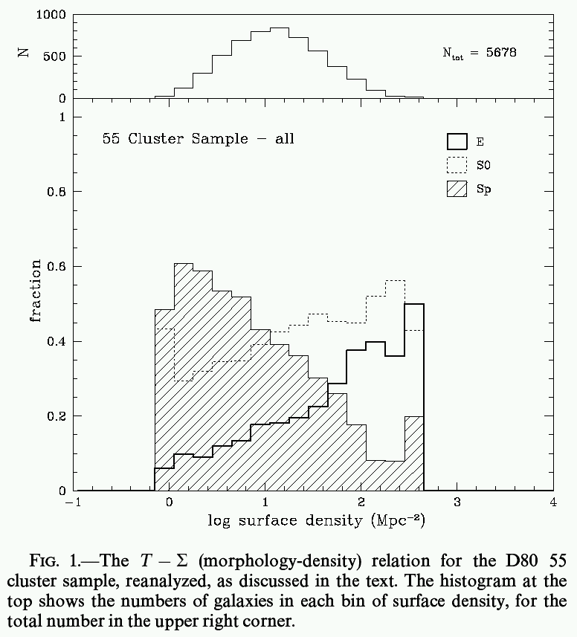
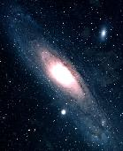
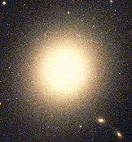
Galaxy evolution & environment
“ Morphology–Density Relation”
Spiral
red, old, low SF activity
E
S0
blue, young, high SF activity
Low-density
High-density
(Dressler 1980)
Notes:
5
ここはLSSを示して、そのうえでM-D relationを示す(Goto et al 2003?)。

Slide 6
No environmental impacts ?
low density
high density
Field
Cluster

Slide 7
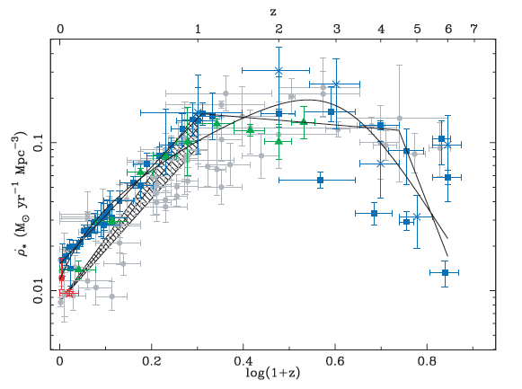
Q: How about in distant universe?
Hopkins & Beacom (2006)

Slide 8
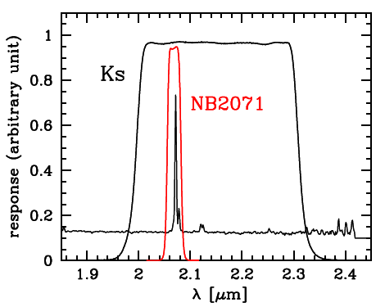
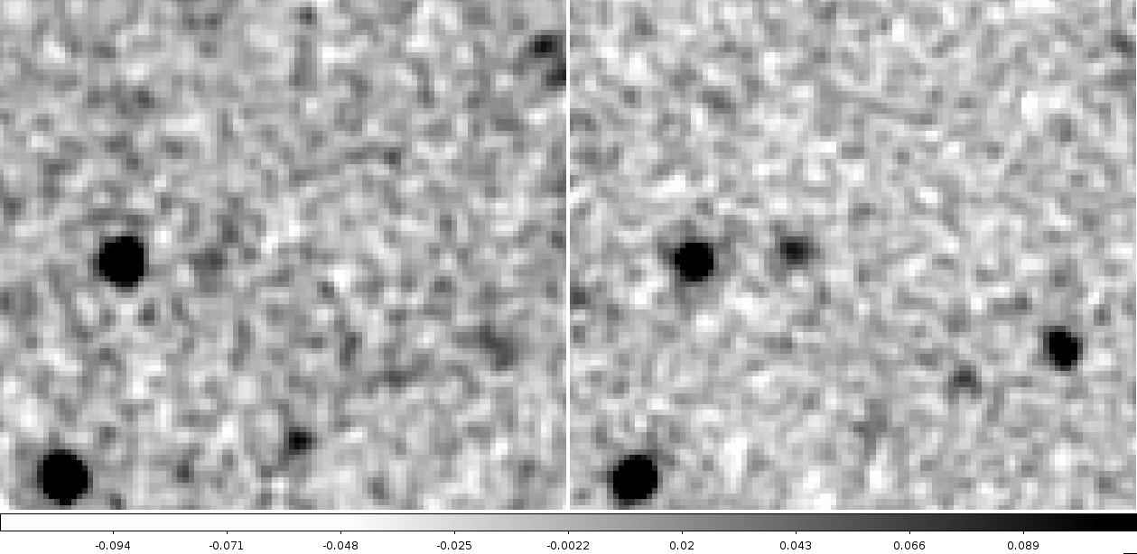
Two big challenges
(1) Distant clusters (z>>1) are very rare.
→ Known (proto-)clusters are now increasing.
(2) Large uniform sample of SF galaxies required.
→ NB emission-line survey is an ideal solution.
BB
NB
BB
NB
Notes:
ここにBB/NBの画像を使ったデモンストレーション

Slide 9
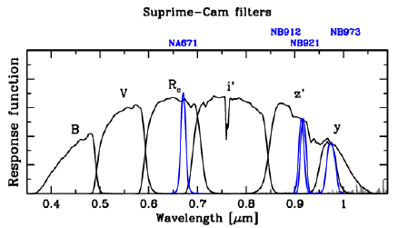
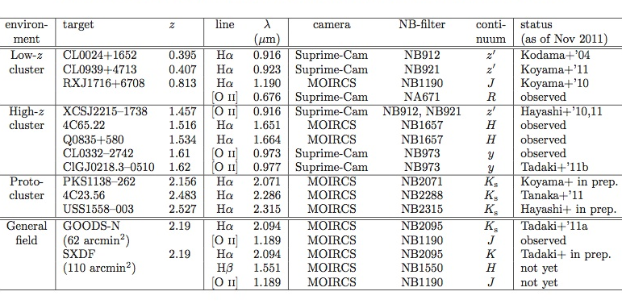
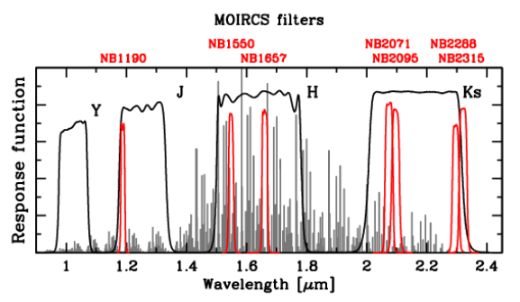
MAHALO-Subaru project
Collaborator: T.Kodama (PI), M.Hayashi, K.Tadaki, I.Tanaka, R.Shimakawa
MApping H-Alpha and Lines of Oxygen with Subaru
Narrow-band Hα/[OII] emission-line survey for 0.4<z<2.5
Dec. 2013
,14
Koyama+ ‘14
Tadaki+’12
Koyama+’13a
Hayashi+’12
Tadaki+’13,14

Slide 10

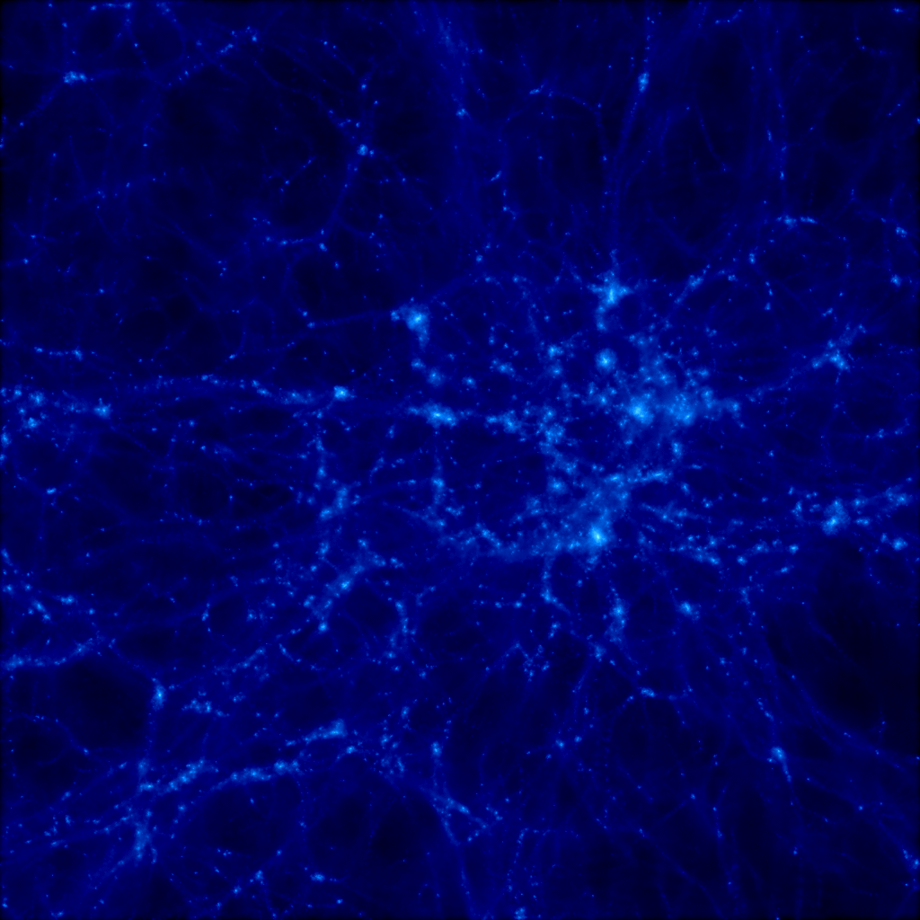
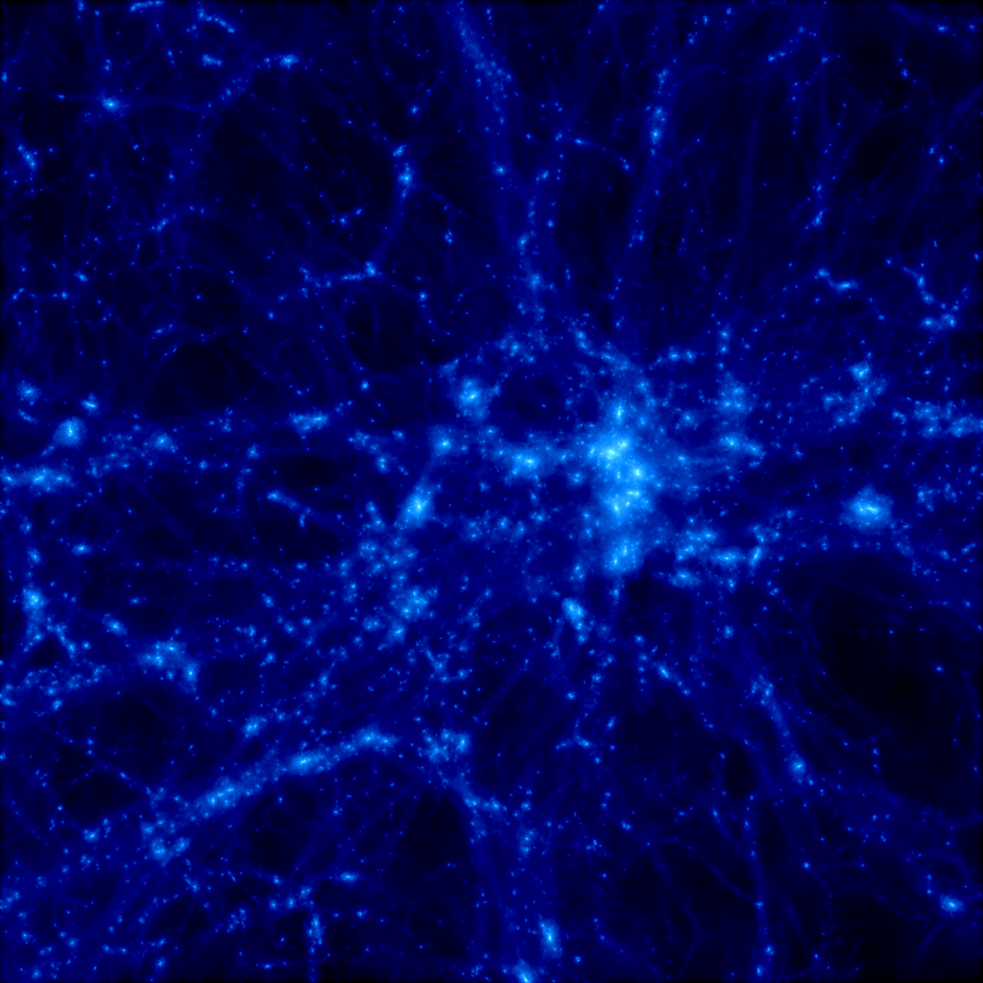
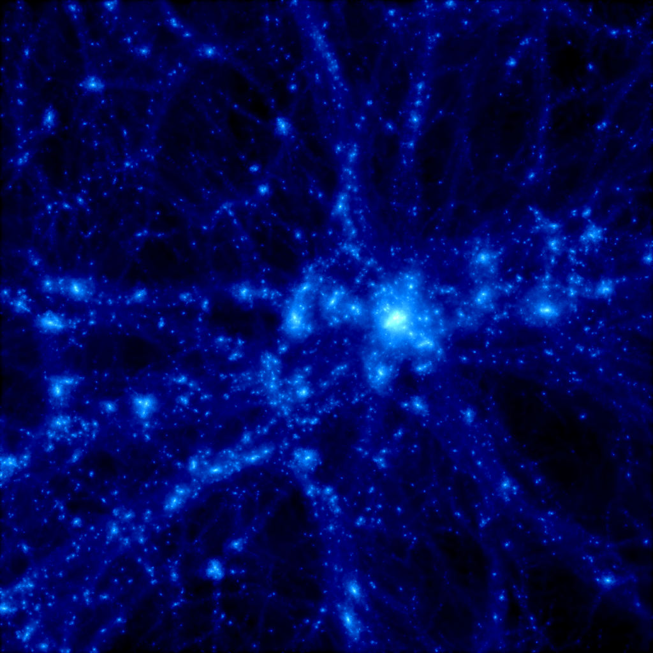
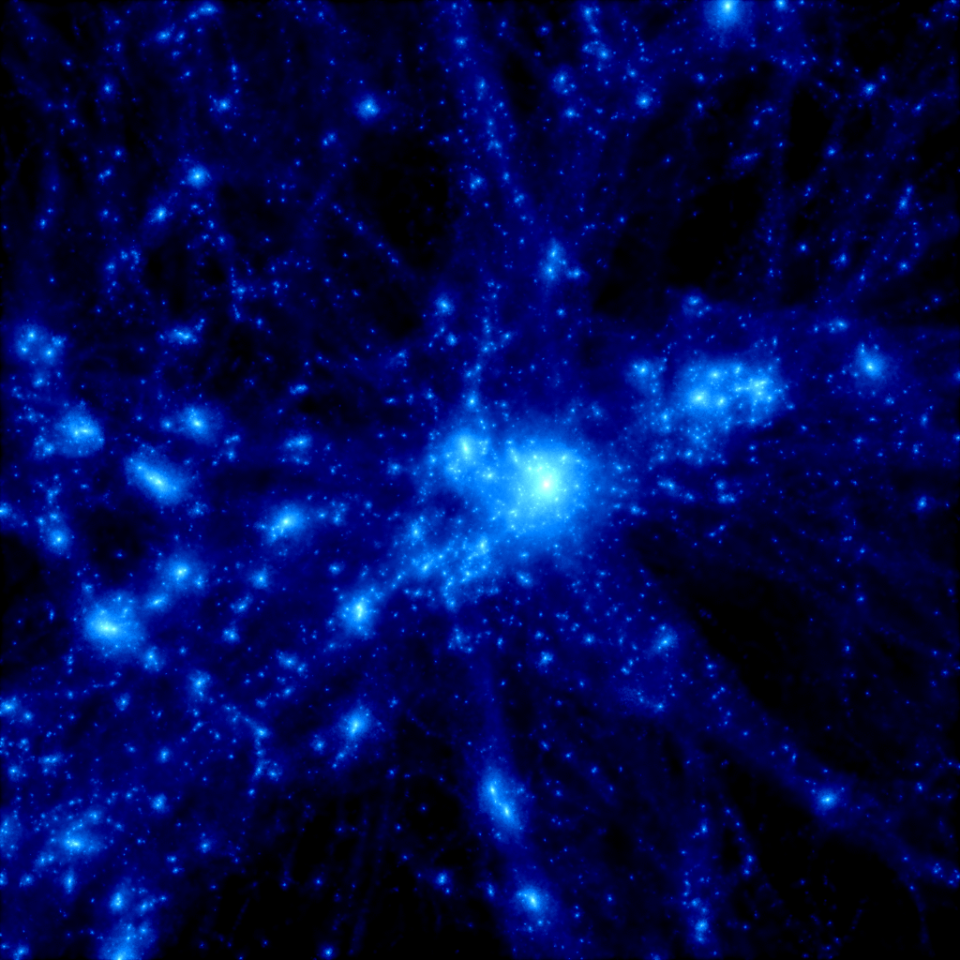
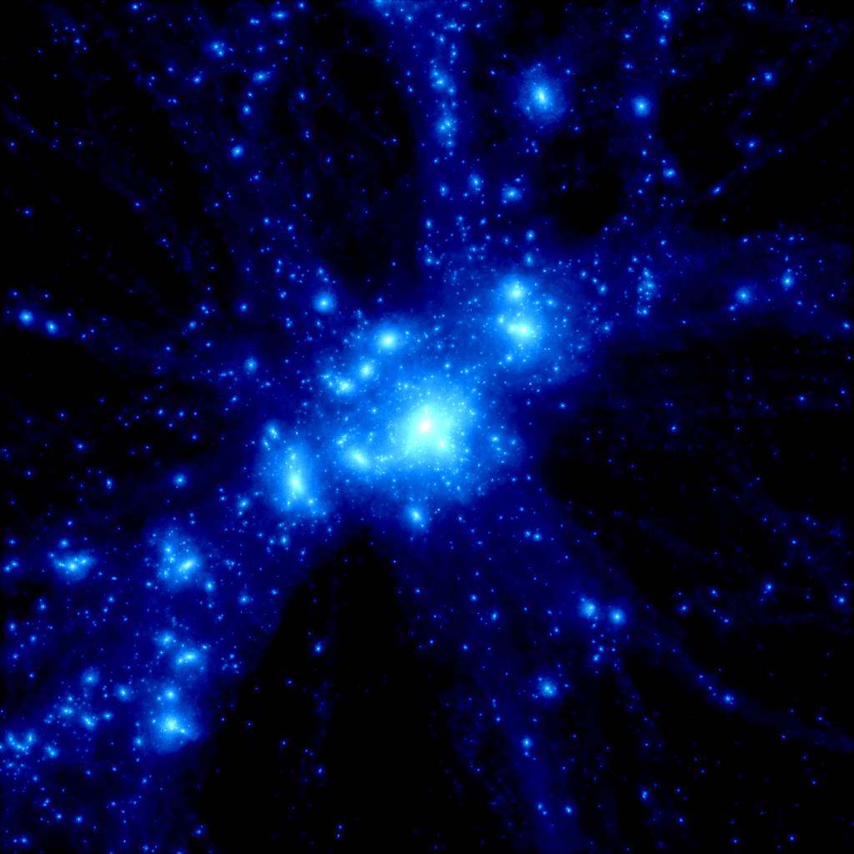
Big advantage of Subaru
z = 30
z = 5
z = 3
MOIRCS
z = 2
z = 1
z = 0
MOIRCS
(4’ x 7’)
Suprime-Cam (34’ x 27’)
M=6×10^14 Msun, 20Mpc×20Mpc (co-moving)
Yahagi et al. (2005)

Slide 11
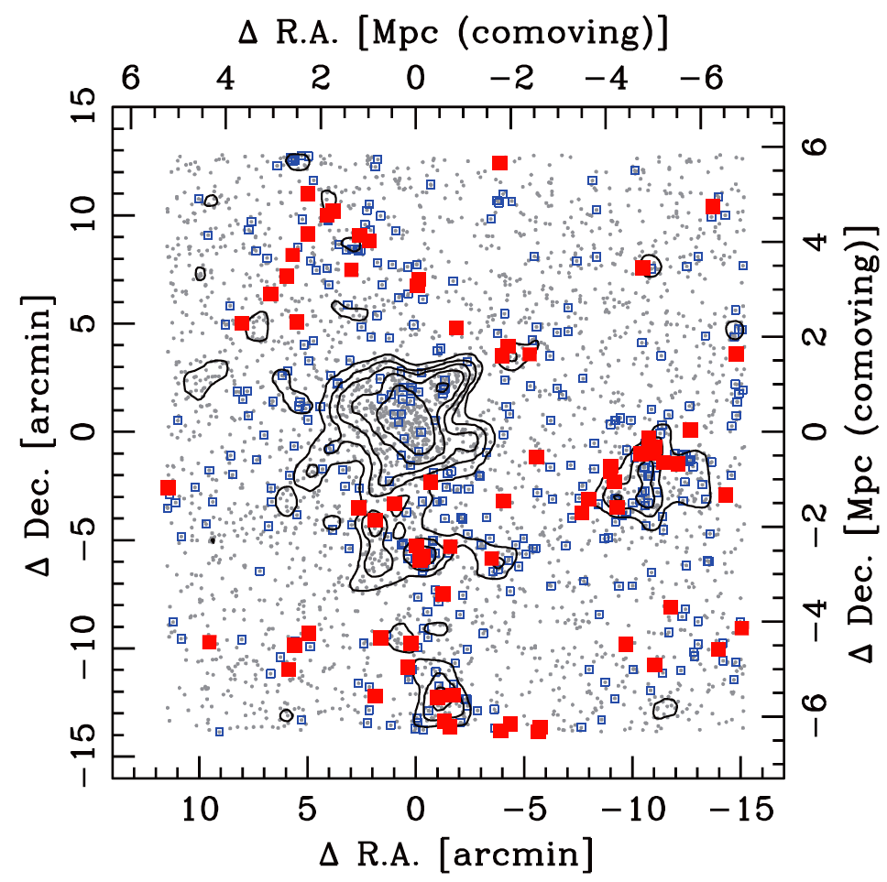
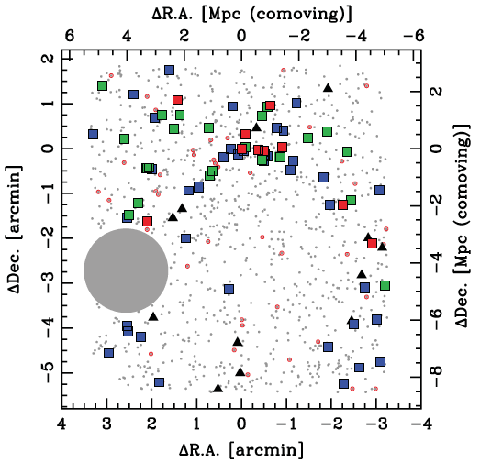
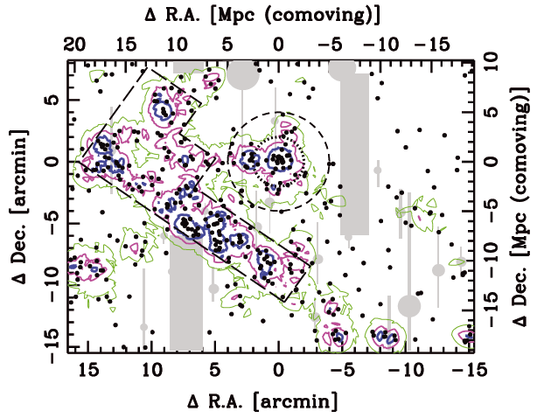
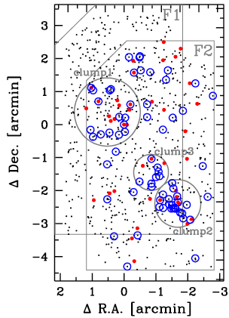
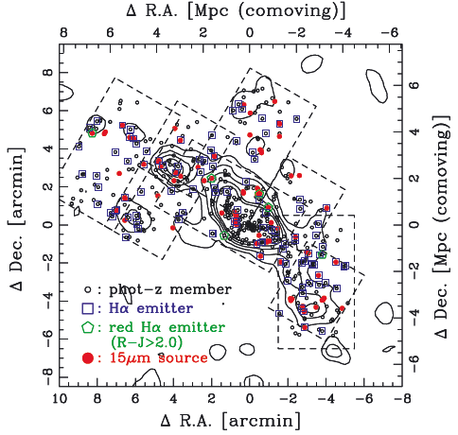
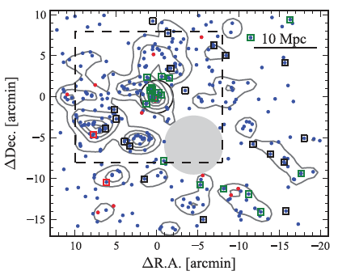
High-z structures revealed by MAHALO
(Hayashi+10, 11)
z=2.2
z=0.4
(Koyama+13)
(Koyama+11)
z=1.5
Many strong emitters
in z>1.5 cluster cores
(Tadaki+12)
z=0.8
z=2.5
z=1.6
(Koyama+10)
(Hayashi+12)

Slide 12
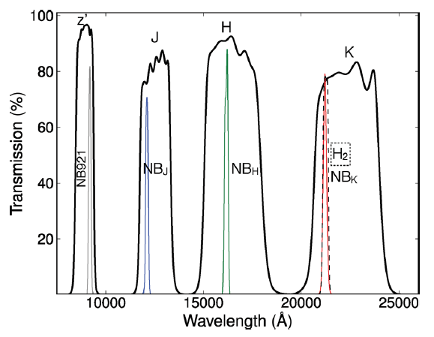
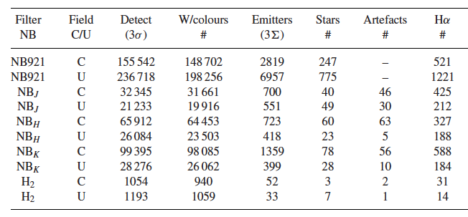
HiZELS: High-Z Emission-Line Survey
Collaborator: I. Smail, D. Sobral, J. Geach, M. Swinbank, P. Best
Hα
@ z=0.4
Hα
@ z=0.8
Hα
@ z=1.5
Hα
@ z=2.2
Total ~2 deg² survey in COSMOS & UDS
~500-2000 Hα emitters at each redshift,
providing excellent comparison sample for our MAHALO cluster samples.
Subaru filter
UKIRT filter
Sobral et al. (2013)

Slide 13
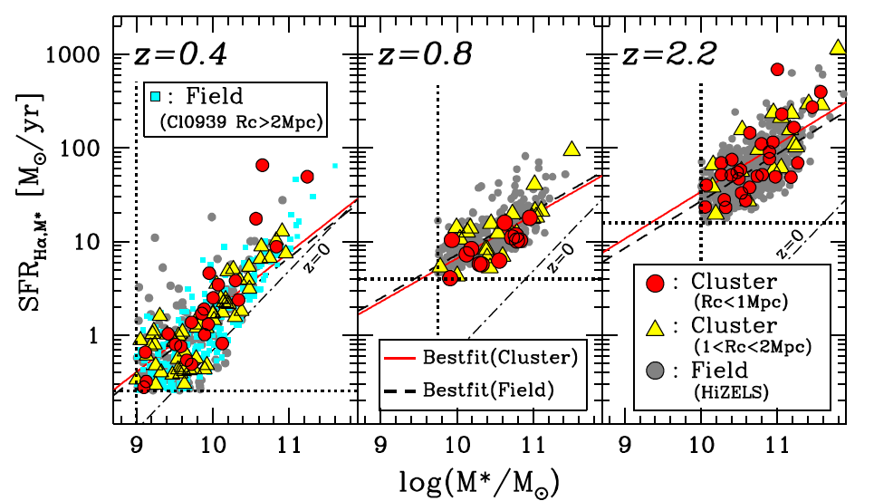
Cluster vs. Field comparison out to z~2
The MS location is always independent of environment since z~2 !
From L(Hα) + M★-dependent dust correction
From rest-frame
R-band photometry
+ M/L correction
Hα emitters with EWr > 30A
(Koyama et al. 2013b, MNRAS, 434, 423)

Slide 14
Interpretation: rapid SF quenching
Cluster

Slide 15

Interpretation: rapid SF quenching
✓
✗
SFR
SFR
Quenching
M★
M★
rapid quenching
slow quenching
: normal SF galaxy
: transitional galaxy
: passive galaxy

Slide 16
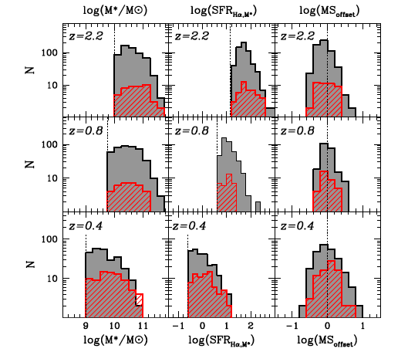
M★, SFR, ΔMS distribution
Excess of massive galaxies in proto-cluster PKS1138-262
SFR
M
SFR
: Field
(HiZELS)
M
: Cluster
SFR
(MAHALO)
M
(Koyama et al. 2013b)

Slide 17
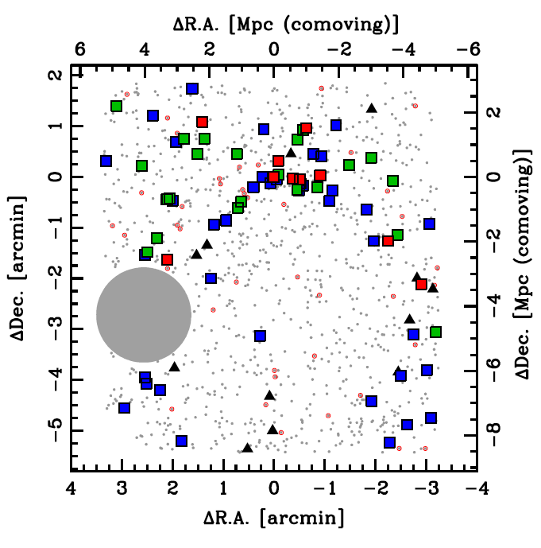
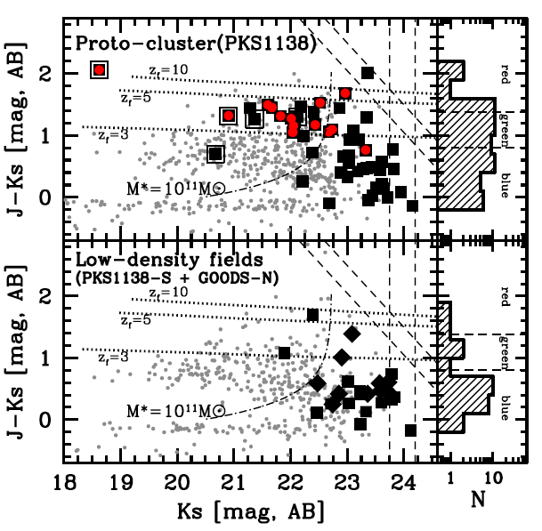
Massive SF galaxies in z>2 proto-cluster
Our MOIRCS+NB(Hα) survey revealed red Ηα emitters dominate the core of z=2.16 proto-cluster (PKS1138-262).
: 24um-source
■: red HAE (J-K>1.4)
■: green HAE (0.8<J-K<1.4)
■: blue HAE (J-K<0.8)
Red emitters are massive (M★ >10¹¹M), and clearly dominate dense environment at z~2.
(Koyama et al. 2013a)

Slide 18
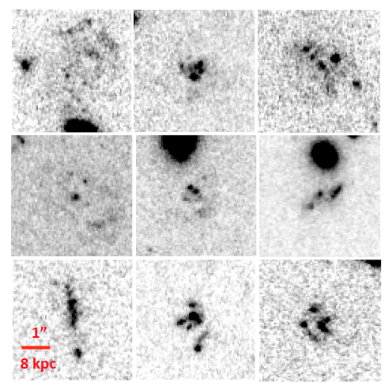
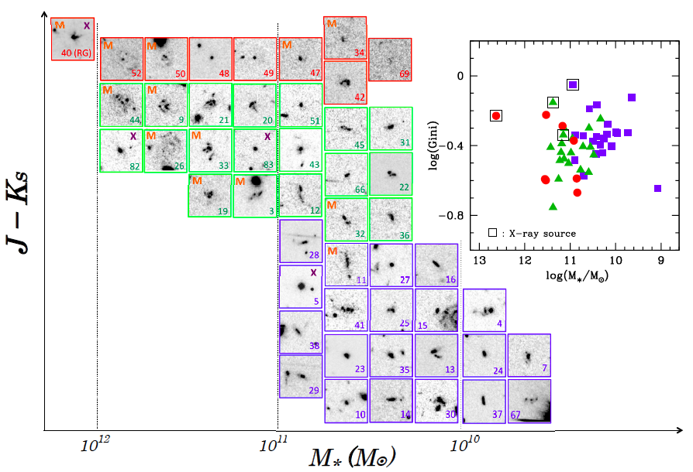
Clumpy galaxies in z>2 proto-clusters
cluster phenomena !
Rest-frame UV morphologies of z=2.2 Hα emitters
in PKS1138 proto-cluster env.
M: 24um source
X: X-ray source
HST/i-band snapshots
(4”x4”=30 kpc for each)
(Koyama et al. 2013a)
Notes:
18

Slide 19
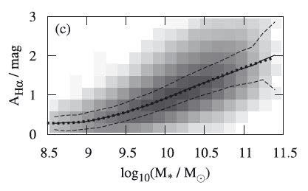
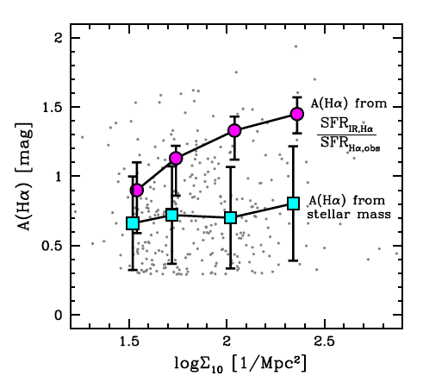
Dust extinction vs. environment (z=0.4)
Dust extinction may be higher in high-density environments.
AHα-M★ relation (z=0)
A(Hα) from
SFR(IR)/SFR(Hα)
z=0.4 sample
(Garn & Best 2010)
A(Hα) from
A(Hα)-M★ relation
(Garn & Best 2010)
(Koyama et al. 2013b)

Slide 20
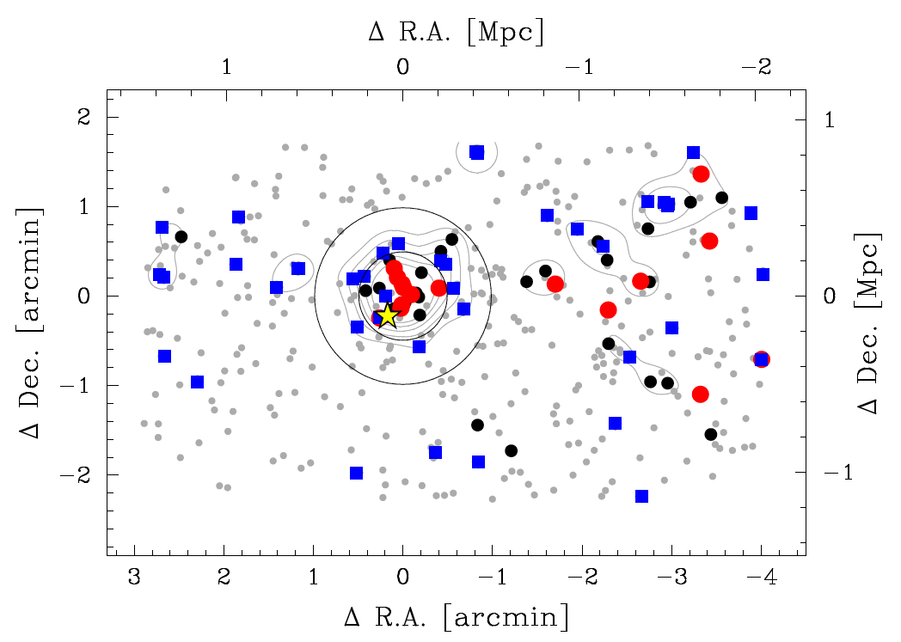
Dust extinction vs. environment (z=1.5)
A new rich, promising cluster at z=1.52, awaiting spectroscopic confirmation.
S-Cam+MOIRCS (Br’z’JHKs+NB1657)
4C65.22 (z=1.52)
● : Red-sequence galaxies
■ : Hα emitters
● : Other photo-z member
(Koyama et al. 2014, ApJ in press, arXiv:1405.4165)

Slide 21
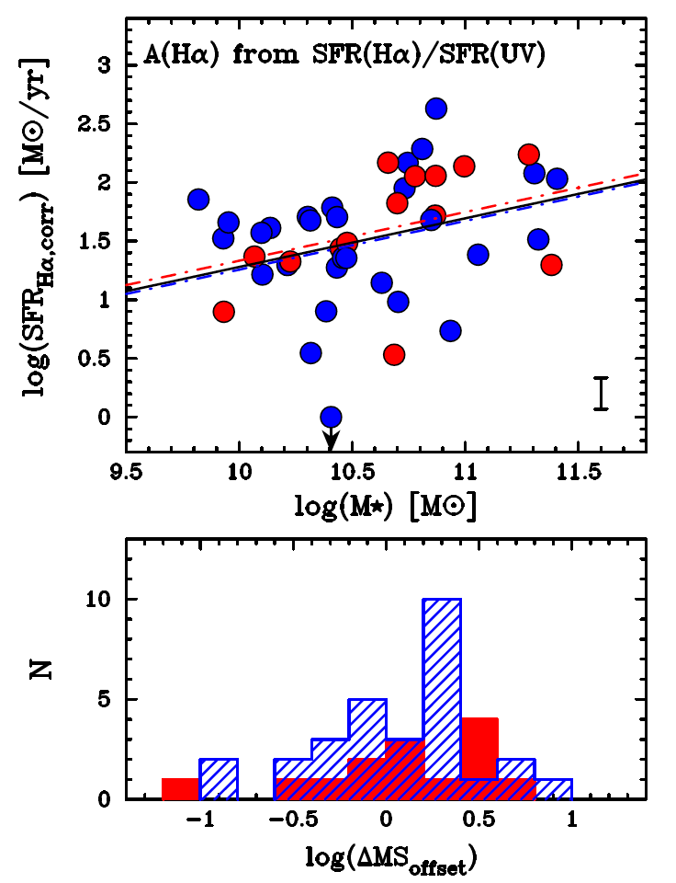
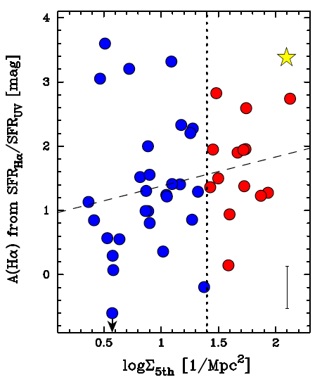
Dust extinction vs. environment (z=1.5)
A similar result for z=1.5 galaxies. Extinction of individual galaxies are corrected with LHα/LUV ratio.
Starburst
Normal (MS)
Semi-passive
Red: cluster
Blue: field
(Koyama et al. 2014)

Slide 22
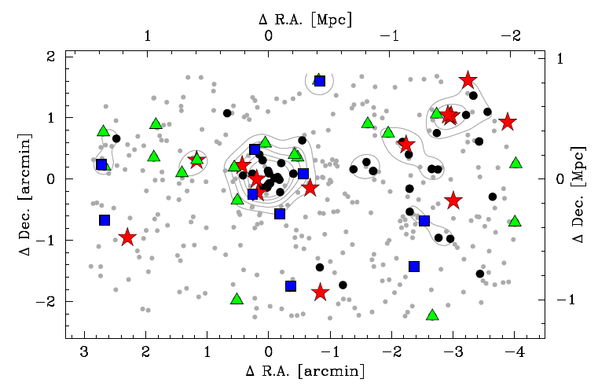
Environment of on/off sequence galaxies
“Bursty galaxies” are most preferentially located in poor group environment?
SF galaxies in poor (in-falling) group: a large fraction of starbursts
SF galaxies near the cluster core: a “mix” of bursty/normal/passive population
★: bursty (logΔMS>0.3)
▲: normal (-0.3<logΔMS<0.3)
■: semi-passive (logΔMS<-0.3)
●: phot-z mem w/o Hα
(Koyama et al. 2014)

Slide 23
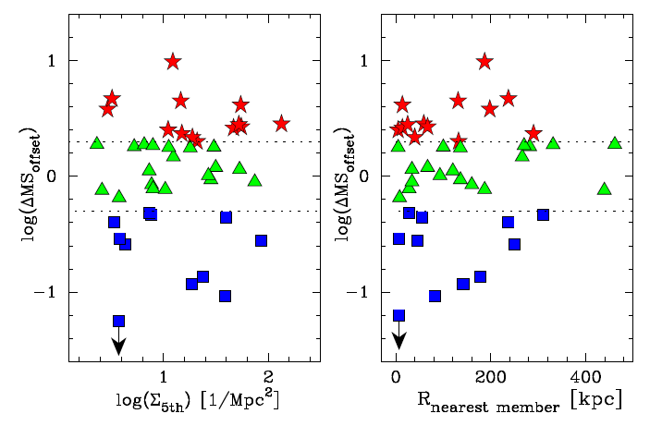
Environment of on/off sequence galaxies
“Bursty galaxies” are most preferentially located in poor group environment?
MSからのSFR方向のオフセット
?
(Koyama et al. 2014)

Slide 24
Conclusions
(1) With MAHALO+HiZELS collaboration, we find that SF main sequence is independent of environment at any time in the history of universe since z~2, suggesting rapid SF quenching.
→ Cluster vs. field difference is always small (~0.1-0.2 dex level)
(2) SF galaxies in z=2.2 proto-cluster environments tend to be more massive (and showing redder J-K colours) than the field counterparts at the same redshift.
→ M★ distribution “along” the MS does depend on environment.
(3) SF galaxies “surviving” in high-density environments tend to be more highly obscured by dust, suggesting a different mode of SF activity in clusters/groups.
→ Environment may affect dust properties (SF geometry or mode).

Slide 25
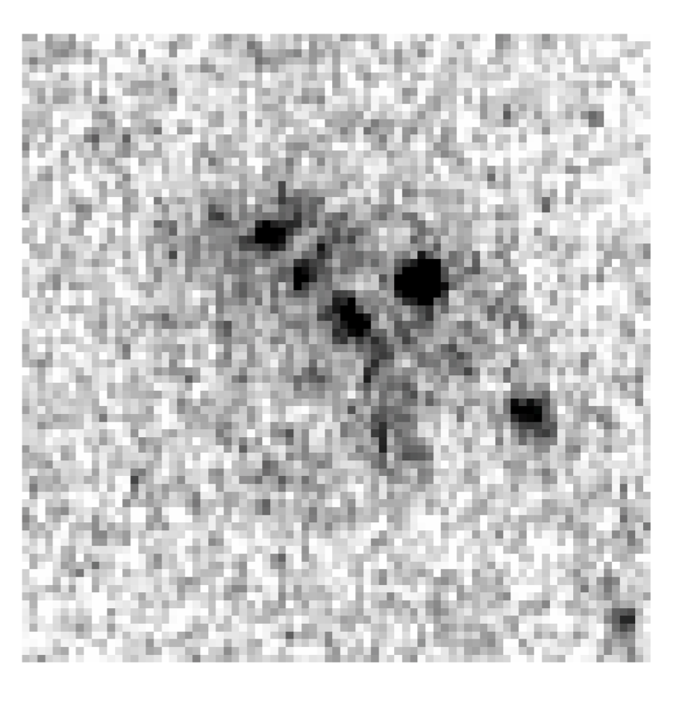
Future Prospect
Completely the same? Or anything different?
rest-UV (ACS)
rest-UV (ACS)
Proto-cluster HAE (z=2)
General Field HAE (z=2)
Koyama et al. (2013)
Tadaki et al. (2013)
Our next step is to obtain “internal” properties of individual galaxies…

